Slide 1
LAB 04
PH142 Fall 2026

Slide 2
Announcements
Lab04: due Sat 9/19 at 11:59 PM (noon)
Quiz03: due Fri 9/18 at 11:59 PM (midnight)
Data Project Part 1: due 9/25 at 11:59pm
* Your group must meet with your assigned GSI before the due date
Midterm I: Fri 10/2 from 8-9am
Midterm review next week during lab!

Slide 3
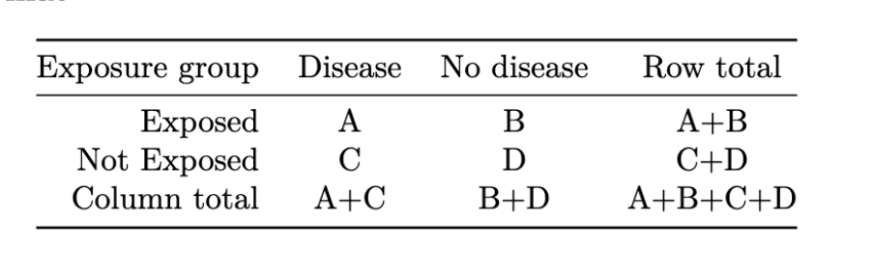
Week 4 Lecture Review
Two-Way Tables
Marginal Distribution: The distribution of a single categorical variable in the entire population
Use the totals in the margins of the table to calculate proportions
Percent of Exposed individuals= (A+B)/(A+B+C+D)
Percent of Unexposed individuals = (C+D) / (A+B+C+D)
Conditional Distribution: The distribution of one categorical variable within the other
Use a single row or column to calculate proportions
Percent of Diseased given exposure = A / (A+B)
Percent of Exposed given disease = A / (A+C)

Slide 4
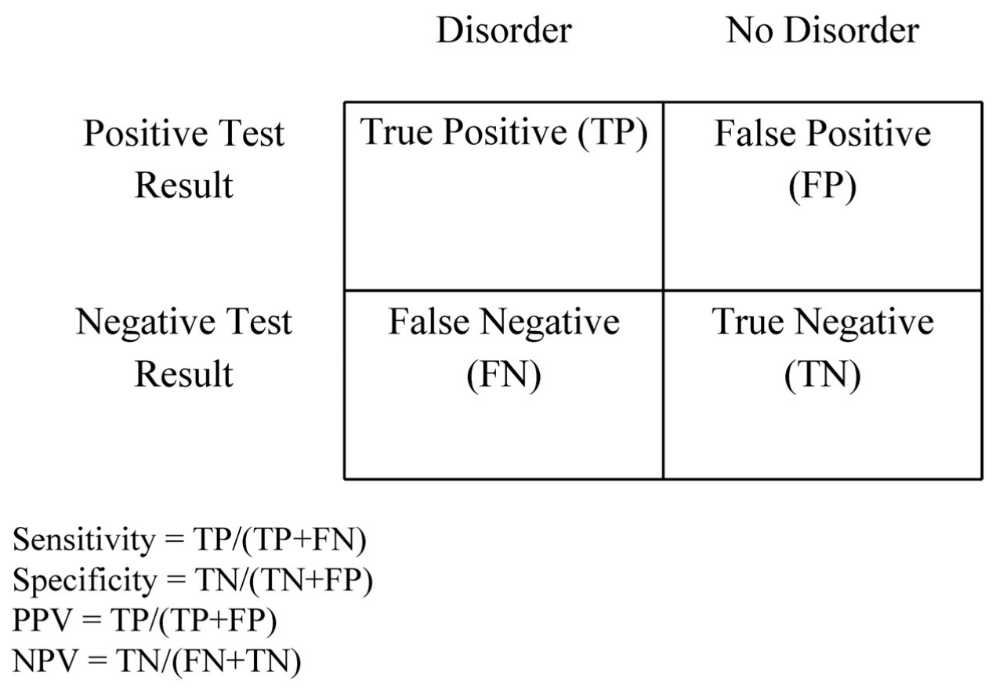
Week 4 Lecture Review
Sensitivity, Specificity, PPV, NPV

Slide 5
Week 4 Lecture Review
Observation vs Experimentation
A study is observational if the researcher observes what happens and does not control who is treated or exposed.
Does not control for confounding
A study is experimental if the investigator is experimenting (or intervening) by controlling who is treated or exposed.
In an experimental study, the exposure is assigned by a randomization mechanism that is controlled by the investigator

Slide 6
Week 4 Lecture Review
Internal and External Validity
Internal Validity
The extent to which the observed results represent the truth in the population we are studying and, thus, are not due to methodological errors
External Validity
The extent to which you can generalize the findings of the study to other situations, people, settings, and measures
Representativeness/generalizability

Slide 7
Week 4 Lecture Review
Population and Sampling
Population of Interest
Target Population - entire group of individuals about which we want estimates to apply *problem in PPDAC*
Study Population - part of the population which we can select individuals & collect information to draw conclusions about the entire population
Study Sample - individuals who have been sampled from the study population; the group that you collect data from

Slide 8
Week 4 Lecture Review
Simple Random Sampling
Simple Random Sample (SRS): A sample chosen by chance, where each individual in the dataset has an equal chance of being selected
Functions in R:
slice_sample(n = 100), selects n rows at random
slice_sample(prop = 0.05), selects a random proportion of rows
set.seed(#), makes results reproducible by taking the same sample
Example: CS_100 <- CS_data %>% slice_sample(n = 100)

Slide 9
LAB 04 Walkthrough

Slide 10
Lab Submission
Follow the directions on the LAB04 file
Submit using the Terminal Tab (next to the console in the bottom left pane)
Copy and paste the given line into the terminal
Follow prompts (NOTE: the terminal will not show your password being typed out!)
CHECK IN GRADESCOPE THAT ALL YOUR TESTS PASSED

